Slide 1



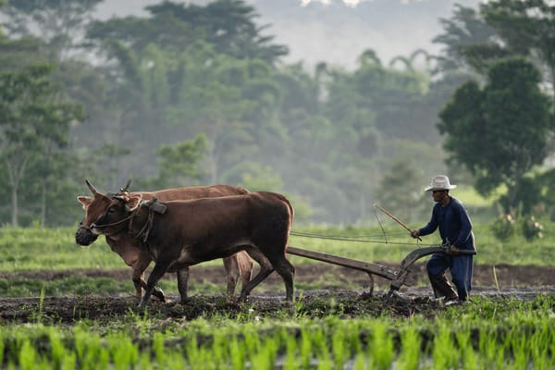

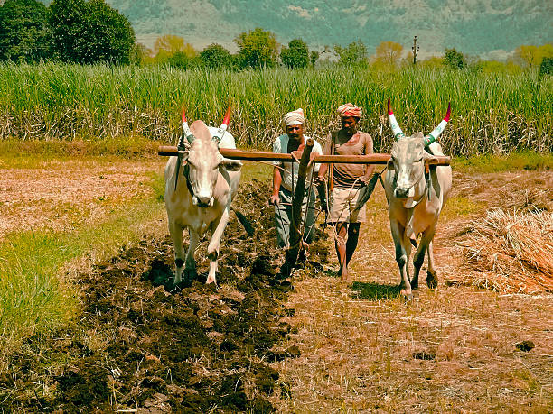
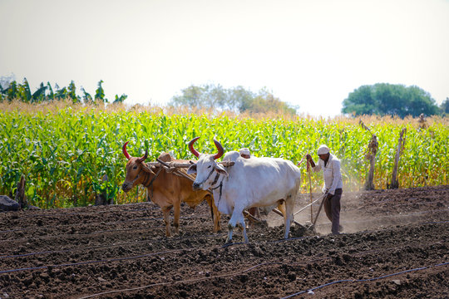
LANGOL
লাঙ্গল
LANGOL
লাঙ্গল

Slide 2
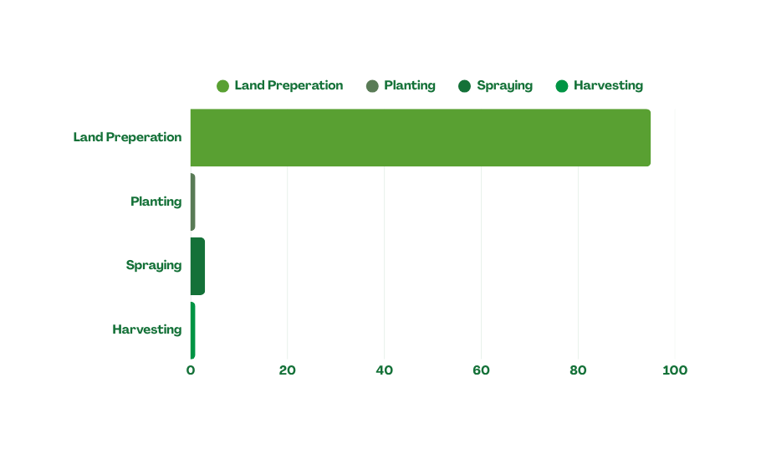
Situation Analysis
Extreme Mechanization Imbalance
Bangladesh Agriculture is Stuck in a Mechanization Deadlock
  ৳3,020 CRORE government subsidy program → FROZEN
  80-90% drop in new machinery sales since subsidy collapse
  40,000+ machines already distributed → sitting IDLE 40-60% of time
Three Converging Crises
LABOR SHORTAGE
  Youth abandoning farming for cities
  Labor wages: ৳600-700/day (all-time high)
  Peak season: Workers unavailable at ANY price
POST HARVEST LEAKAGE
THE MIDDLEMAN TAX
  Traditional brokers charge 20-40% commission
  Eye-ball area measurement = 10-15% payment dispute
  Farmer effective cost: ৳5,882/acre (should be ৳4,000)
  Lack of precision tech results 10-14% loss in cereals and up to 50% loss in fruits and vegetables
  Inefficiency stems from a total lack of organized connectivity between machine owners and smallholder farmers

Slide 3



Problem Statement
Agri-Machinery Distribution Crisis
৳11,000 CRORE machinery market + 40,000 machines already exist + High farmer demand
= Machines IDLE while crops ROT
Unaffordable Ownership
Income Drain
01
Smallholders can't buy ৳32 Lakh machines
04
20-30% farmer earnings lost to inefficiencies
Middleman Exploitation
Food Security Risk
02
Overcharges + underpayments; no land
area verification
05
Scaling population (200M by 2030) amid crop waste
Booking Chaos
Failed Fixes
03
Shortages in peaks; no on-demand access
06
Govt subsidies corrupt/ineffective; imports strain reserves

Slide 4



Solution
Introducing LANGOL app
We connect farmers directly to machinery owners through a transparent, IoT-verified digital marketplace.
On-Demand
Machinary
Rentals
IoT Verified
Precision Tracking
Secure
Payments
Hybrid Agent-Led
Ecosystem

Slide 5
Solution
On-demand booking via app or local LANGOL Point for instant tractor/harvester rentals
Secure payments via bKash/Nagad digital + cash,
with prepaid owner wallets
Inclusive access for no-smartphone farmers via agent calls or shop visits, serving all 15M smallholders
IoT-verified billing with custom trackers to measure exact acreage, pay only for work done, zero disputes

Slide 6






how
works
LANGOL
1. REQUEST - Farmer books tractor via app or visits LANGOL Point agent
2. MATCH - Smart system finds nearest available machine (reduces wait time)
3. TRACK - IoT device records exact area worked (not estimates)
4. VERIFY - Farmer approves work via SMS or app notification
5. SETTLE - Payment auto-released (digital/cash): Owner gets paid, Agent gets commission

Slide 7
Business Model
Key Partnership
Key Activities
Value Proposition
Customer
Relationships
Key Resources
  Machine Owners & Fleet Operators
  LANGOL Points (Local Agents)
  Agri Brands
  IoT/GPS Hardware Suppliers
  Platform Development (Apps)
  IoT Device Management
  Fleet Onboarding & Verification
  Agent Network Expansion
Farmers:
  Zero middlemen, fair pricing
  IoT-verified transparent billing
Owners:
  Higher machine utilization
  Remote monitoring prevents theft
Agents:
  Risk-free commission income
  Community Trust via LANGOL Points
  Self-Service Mobile Platform
  Rating & Review System
  24/7 Support Helpline
  Proprietary Matching Algorithm
  IoT/GPS Tracking Infrastructure
  Agricultural Data Asset
  Tech & Field Operations Team
Customer Segments
Channels
  Marginal & Smallholder Farmers
  Machinery Entrepreneurs
  Non-Tech Savvy Farmers (via Agents)
  Target: 0.5-5 acre landholders
Direct: Farmer & Owner via App
Indirect: Physical LANGOL Points
Marketing: Campaign, rural miking, meetings
Word-of-mouth referrals
Cost Structure
Revenue Streams
  Tech Maintenance (Server/App)
  IoT Device Inventory
  Marketing & Rural Outreach
  Field Operations & Support
  15% Commission per Booking
  B2B Advertising (Agri Brands)
  IoT Device Sales
  Additional Services (Future)

Slide 8
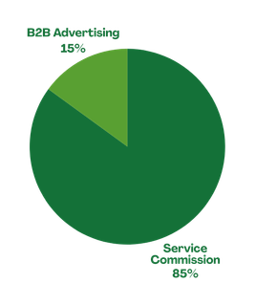
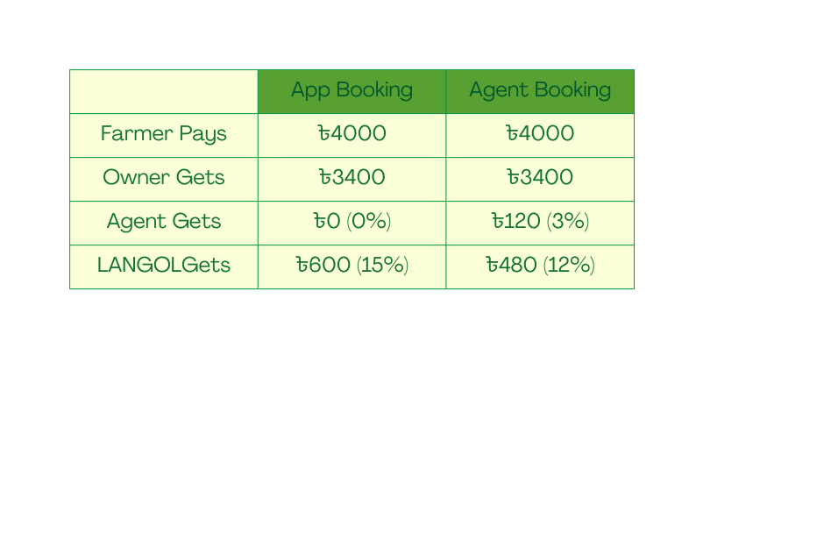
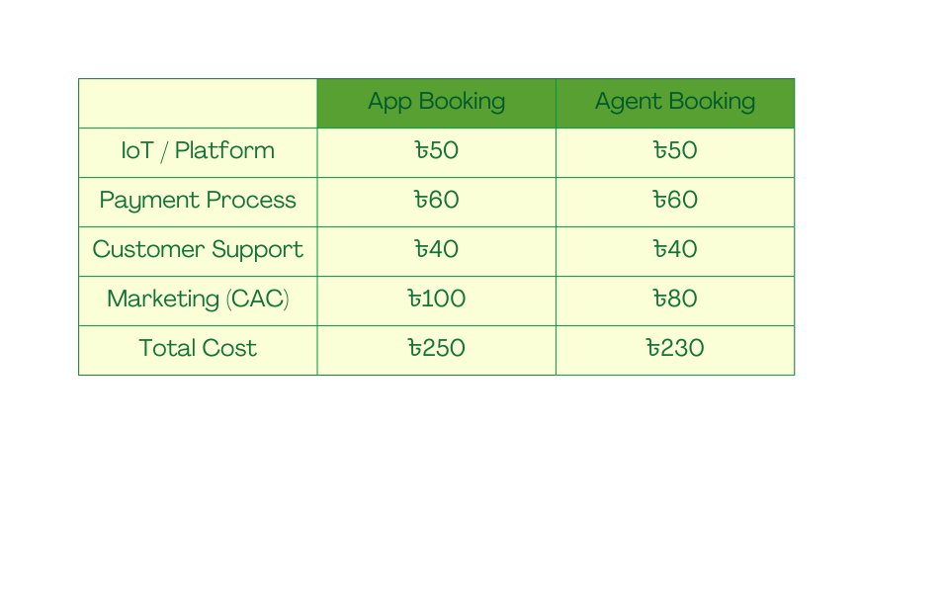
How We Make Money
STREAM 1
Service Commission 85%
  We take 15% Commission on every successful booking
Farmer Pays ৳4,000 | Owner Gets ৳3,400
App Booking → LANGOL 15%
Agent Booking → LANGOL 12% + Agent 3%.
STREAM 2
B2B Advertising 15%
Agri-input brands like ACI, Syngenta, and Mahindra pay us to show targeted ads directly to farmers on our platform.
Right product, right farmer, right season.
Per Booking Breakdown
Cost Per Booking
Blended Revenue: (600 × 0.4) + (480 × 0.6) = ৳528
Blended Cost: (250 × 0.4) + (230 × 0.6) = ৳238
Blended Profit: ৳290
Blended Margin: 55%
55%
Margin
42 : 1
LTV : CAC

Slide 9
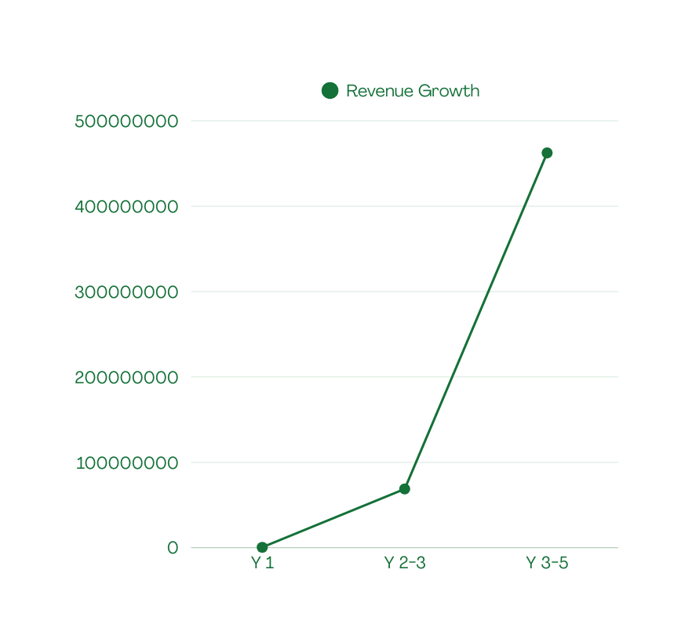
Revenue Growth Line
Phase Breakdown
Metric | Phase 1 | Phase 2 | Phase 3
Districts | 3 | 15 | 40
Farmers | 1,000 | 30,000 | 300,000
Machines | 75 | 1,000 | 5,000
Agents | 50 | 500 | 2,500
Bookings | 1,000 | 100,000 | 800,000
Revenue | 0.05 Cr | 6.88 Cr | 46.24 Cr
Cost | 0.90 Cr | 6.23 Cr | 27.58 Cr
Profit | -0.85 Cr | 0.65 Cr | 18.66 Cr
Monthly Avg | 0.4 L | 28.7 L | 192.7 L
46.24 Cr
6.88 Cr
0.05 Cr

Slide 10
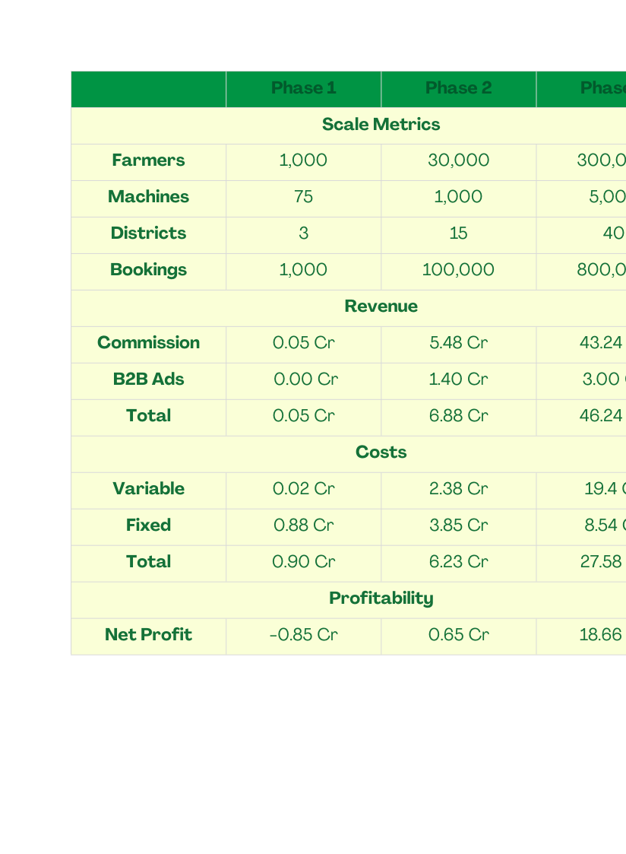
Financial Projections
5-Year Financial Projections
55%
Margin
42 : 1
LTV : CAC
1.2
Months
Playback
2,042%
ROI
5 Years

Slide 11
Funding Ask
Use of Funds (Phase 1 - Year 1)
40% | Technology | 36 Lakh
 | IoT Hardware | 15 L
 | App Development | 12 L
 | Cloud Infrastructure | 6 L
 | Payment Gateway | 3 L
33% | Team | 30 Lakh
 | 6 core members [CEO, CTO, COO + 3] | 30 L
33% | Operations & Marketing | 30 Lakh
 | 6 core members [CEO, CTO, COO + 3] | 30 L

Slide 12
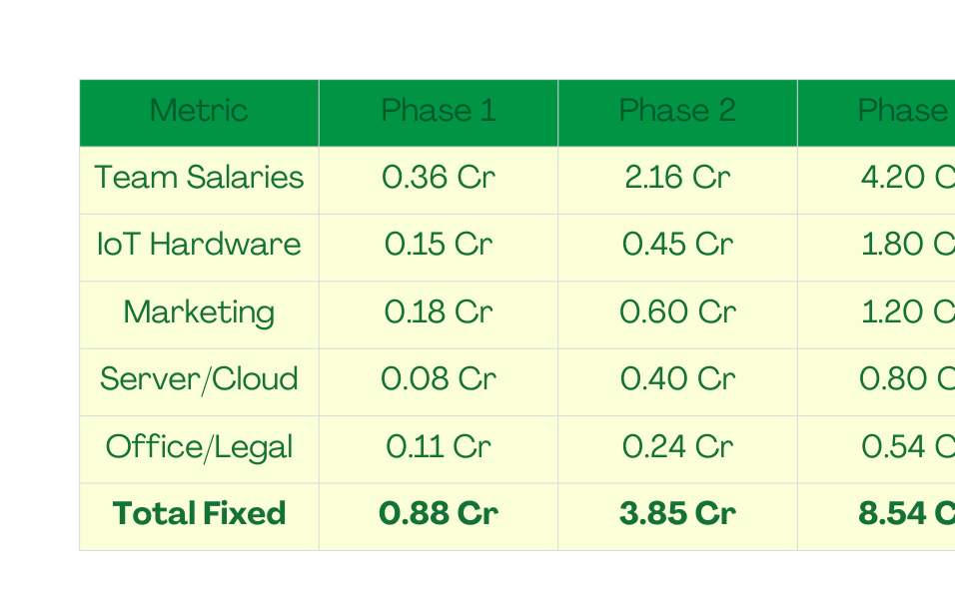
Cost Structure
Fixed Cosr (By Phase)
Variable Cost (Per Booking) | Variable Cost (Per Booking)
IoT/Platform | 50
Payment Processing | 60
Customer Support | 40
Blended Marketing (App+Agent) | 88
Total Per Booking | 238
 | Phase 1 (1 year) | Phase 2 (2 year) | Phase 3 (2 year)
Total Cost | 0.90 Cr | 6.23 Cr | 27.58 Cr

Slide 13
Market Validation
(Primary Research)
FARMER SURVEYS
(150 farmers interviewed)
  89% struggle to find machinery during peak season
  76% believe middlemen overcharge
  82% interested in app-based booking if agent available
  67% willing to pay 10-15% platform fee for transparency
MACHINE OWNER SURVEYS (40 owners interviewed)
  71% report <40% annual machine utilization
  85% interested in platform to find more customers
  93% willing to install GPS for transparent billing
  Avg. willingness: ৳5,000 one-time IoT cost acceptable
AGENT SURVEYS
(25 rural shopkeepers)
  88% interested in earning commission
  Expect ৳1,500-2,500/month additional income
  76% already serve farming community daily
“I never know which machine is available or where to find one. On top of that, I feel cheated on the land size. If an app helps me find a machine instantly and shows the exact area using GPS, I would trust it completely.”
– Salim , 2-acre farmer, Cox’s Bazar
“I have customers, but they are scattered. I waste too much time going from one field to another without a plan. If an app helps me schedule my day and connects me to farmers in the off-season, installing a sensor is a smart move.”
– Mojahid, Machine Owner, Bogura
“Farmers come to my shop for everything, seeds, fertilizer, and advice. They trust me, but they struggle to find machines on time. If I can book a machine for them through an app and earn a small commission, it’s a win for everyone.”
– Sumon, Shop Owner, Feni

Slide 14
Operational Plan
Q1 (DEC '26 - FEB '27): FOUNDATION
Q2 (MAR - MAY '27): SOFT LAUNCH
INFRASTRUCTURE
✓ Register company (RJSC)
✓ Raise ৳90 lakh seed funding
✓ Open Dhaka office, hire 6-person core team
✓ Develop MVP app (Farmer + Owner + Agent dashboard)
✓ Import & test 100 IoT devices
TEAM BUILT (6 people)
• CEO: Strategy, fundraising, partnerships
• CTO: App development, IoT integration
• Operations Manager: Field coordination
• 3 District Coordinators (Mymensingh, Jessore, Bogura)
MILESTONE: MVP ready, team operational, IoT tested
SUPPLY SIDE (Machines)
✓ Identify 150 machine owners across 3 districts
✓ Onboard 75 machines (50% conversion)
✓ Install IoT devices on all machines
✓ Train operators on professional service delivery
DEMAND SIDE (Farmers)
✓ Field demos in 30 villages (600 farmers attend)
✓ Recruit 10 LANGOL Point agents
✓ First 100 farmers sign up (friendly pilot users)
TECHNOLOGY
✓ Beta test with 50 bookings
✓ Fix bugs, improve UX based on feedback
✓ Integrate bKash/Nagad payment
MILESTONE: 75 machines live, 250 bookings completed, system stable

Slide 15
Operational Plan
Q3 (JUN - AUG '27): SCALE OPERATIONS
Q4 (SEP - DEC '27): OPTIMIZE & PREPARE
GROWTH
✓ Expand to 20 LANGOL Point agents
✓ Onboard 25 more machines (total 100 machines)
✓ Acquire 500 active farmers (word-of-mouth growth)
✓ Launch Facebook/rural marketing campaigns
PARTNERSHIPS
✓ Pilot B2B campaign with 1 agri-input brand
✓ Explore BRAC/Grameen partnership discussions
METRICS
✓ Target: 400 bookings (Jun-Aug)
✓ Customer satisfaction: 4.2+ star rating
✓ Repeat booking rate: 30%+
MILESTONE: 750 total bookings, profitable monthly ops, agent network functioning
REFINEMENT
✓ Reach 1,000 farmers (cumulative)
✓ Complete 1,000 successful rentals (target achieved)
✓ Reduce cost per acquisition by 20% via referrals
✓ Improve IoT accuracy to ±3% (from ±5%)
FINANCIAL
✓ Achieve monthly break-even by Nov/Dec
✓ Validate unit economics (LTV/CAC > 4X)
✓ Close Year 1 with ৳1.5 Cr cash reserves
PHASE 2 PREP
✓ Finalize expansion plan for 15 new districts
✓ Prepare Series A pitch deck
✓ Hire 2 regional managers for Phase 2
MILESTONE: 1,000 rentals completed, model validated,ready to scale Phase 2

Slide 16

Competitor Analysis
Traditional Middlemen (Existing System)
  Farmer contacts middleman personally or via phone
  Middleman owns or has relationships with machine owners
  Charges 35-45% markup
  Manual measurement (rope/visual estimation)
  Cash-only transactions
Market Share: 90-95% of current market
Strengths:
  Established relationships
  Deep local knowledge
  No technology barrier
  Immediate cash transactions
  Personal trust
Weaknesses:
  High cost to farmers (40% markup)
  Frequent cheating on land measurement
  No transparency
  Machine availability uncertain
  No quality guarantee
  No recourse for disputes
LANGOL's Advantage
  15% commission vs. 40% markup = Farmers save 25%
  GPS verification eliminates measurement cheating
  Real-time availability = No waiting days
  Rating system = Quality accountability
  Transparent dispute resolution

Slide 17
Competitive Advantage
IoT-Verified
Transparency
Hybrid
Phygital Model
First-Mover
Advantage in Data
  GPS tracker installed on every machine
  Real-time tracking of exact area worked
  Automated billing based on GPS data
  Farmer can see map overlay proving coverage
  70% of bookings via physical agents (village shopkeepers)
  30% via app
  Agents bridge digital divide
  Which districts need which machines when
  Pricing elasticity (how demand changes with price)
  Machine utilization patterns
  Soil conditions, field sizes, crop yields (via machine work)

Slide 18
Market Size
TAM (Total Addressable Market)
  18.9 million smallholder farmers in Bangladesh (farms <2.5 acres)
  Average machinery rental spend: BDT 10,000-15,000/year per farmer
  Total Market Size: ~BDT 170-225 billion/year (~$1.5-2 billion USD)
TAM
SAM
SAM (Serviceable Available Market)
  Target: Farmers with 0.5-5 acres (most mechanization-dependent segment)
  Approximately 12 million farmers
  Realistic market capture: BDT 100-120 billion/year
SOM (Serviceable Obtainable Market)
  Year 1: 50,000 farmers across 3 districts
  Year 3: 500,000 farmers across 15+ districts
  Revenue potential (Year 3): BDT 600-900 million (~$5-7 million USD)
SOM

Slide 19
Go-To-Market Strategy
Phase-1
Pilot Launch
Phase-1 (Pilot Launch)
Phase-2
Expansion
Duration - 1 year (Dec, 2026 to Dec, 2027)
Machinary Owner Onboarding
  Direct Outreach
  Register Machines after a manual machine screening process
Targeted Location
Phase-3
Dominance
  3 districts: Mymensingh (Highest in rice production), Jashore (Highest in vegetable production), Bogra
  High concentration of farmers creates networking easier
Farmer Aqusition
  Village Meetings
  Leaflets, posters and placards for better reach out
  Offer discounts on first rentals
Key Milestones
  1,000 farmers and 50+ machinary owners (50-100 machines)
  30-50 Agents (Village Shopkeepers)
  1,000 successful rentals
  Proof of concept
Agent Recruitment
  Assist local shopkeepers to be LANGOL Agents
  1 week training
  Partnership Agreement

Slide 20
Go-To-Market Strategy
Phase-1
Pilot Launch
Phase-2 (Expansion)
Strategic Partnerships
Phase-2
Expansion
Duration - 2 year (Jan, 2027 to Dec, 2028)
  Machinery Manufacturers like ACI, Mahindra etc.
  Spare part owners
  bKash, Nagad - exclusive payment partnership
Targeted Location
Phase-3
Dominance
  Reach out to 15+ districts
  Prioritize rice belt (North), potato belt (Southwest), vegetable zones (East)
Marketing Scale-Up
  Facebook Ads targeting farmers in expansion districts
  YouTube tutorials and success stories
  Campaigns during planting/harvesting seasons
Key Milestones
  30,000+ active farmers
  1000+ machine owners
  500+ agents
  100,000 successful rentals
  Implement solar powered cold storage
  Build Analytic Dashboard
Key Actions
  Hire 18 team members
  Secure a series of funding
  Upgrade platform (AI Matching, GPS Tracking)

Slide 21
Go-To-Market Strategy
Phase-1
Pilot Launch
Phase-3 (Dominance)
Marketplace Expansion
Phase-2
Expansion
Duration - 2 year (Jan, 2029 to Dec, 2030)
  Add seeds, fertilizers and pesticides, One Stop Solution
  Connect farmers to buyers/wholesalers
  Transportation Service
  Agronomists Consultation (subscription model)
Geographic Coverage
Phase-3
Dominance
  All 40+ districts in Bangladesh
  Urban peri-agricultural zones
Technology Platform
Key Milestones
  AI powered Agriculture
  Crop planning recommendation
  Weather-based optimal timing alerts
  Pest/Disease early warning
  300,000+ active farmers
  5,000+ machinery owners and agri-entrepreneurs
  800,000+ successful rentals
  500+ cold storage units
  Market leader position in agri-machinary rentals
Key Actions
  Digital Marketing Campaign
  Fund raising
  Establish 5 Regional Hub Offices
  Hire 40 total team members

Slide 22








Impact
Economic Impact
  20-30% reduction in production cost
  15-20% increase in net income
  Transforms idle assets into steady income streams
Social Impact
  Reduce national post harvest loss
  Rural employment creation
  Empowers smallholder by democratizing access to technology
Environmental Impact
  Better equipment allows for 3 crops/year instead of 2 on the same land
  Address the 5.13M tones wasted
annually from 52.57M tones produced

Slide 23
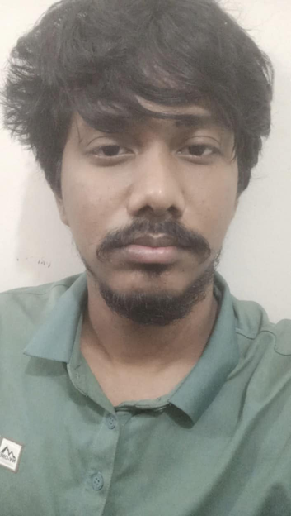
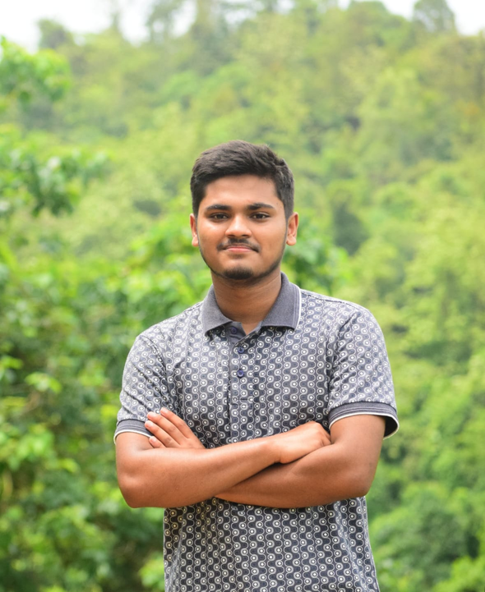


Team
Team “kichu ekta kora lagbe”
Washiul Istiak
Hisham
Tanvir Ahmed
Moshud Muktadir
EEE,BUET
ARABIC,CU
EEE,BUET
Co-Founder
UI/UX & Product
Designer
Team Leader/CEO
kichu ekta kora lagbe

